Slide 1
Big Data Ecosystem
Day -3

Slide 2
What we can learn today ??
Azure Data Ecosystem
Storage (Blob Vs Data Lake)
Data Factory
Data Lake Storage
Data Lake Analytics
How about automating any ELT / ETL projects .
Heard of the Hype on DataBricks ??
Integrate Data factory with Data Bricks

Slide 3
Being More Specific
9-10 AM : Introduction & Overview
10-11:00 : Data Lake Storage & Analytics
11:00-11:15 : BREAK !!!
11:15-1:00 : Data Factory & its Automation Part -1
1-2 PM : LUNCH.
2-3:30PM : Automation Part -2
3:30-3:45 : Break
3:45-5PM : Data Bricks Intro

Slide 4
Time to adapt is shrinking
A hundred years ago, the average lifespan of a company listed on the S&P 500 index was 67 years
In the 2020s…
75% of the S&P 500 will be new (not on the index today)
25% of the S&P 500 will
be ones on the index today
Source: BBC
Notes:
Compared to the past, what’s unique about the disruption happening today is its pace. During past revolutions, firms had many years, even decades, to adapt. Today, that is no longer the case. One indicator of just how fast the landscape is changing is the longevity of companies on the S&P 500, an index of leading US companies.
A hundred years ago, the average lifespan of a company listed on the S&P 500 was 67 years. Today, that average lifespan has decreased to just 15 years.
Experts predict that in the next decade, only 25% of the companies currently listed on the S&P 500 will remain there, and the other 75% will be replaced by new companies.
The bottom line is, today’s organizations must adapt quickly to change, using new technologies that fuel competitive advantage, or risk getting left behind.
-------------------------------------------
Statistics source:
BBC, 2012, quoting Richard Foster - http://www.bbc.com/news/business-16611040
"The average lifespan of a company listed in the S&P 500 index of leading US companies has decreased by more than 50 years in the last century, from 67 years in the 1920s to just 15 years today, according to Professor Richard Foster from Yale University. Professor Foster estimates that by 2020, more than three-quarters of the S&P 500 will be companies that we have not heard of yet."

Slide 5
Experts predict that in the next decade, only 25% of the companies currently listed on the S&P 500 will remain there, and the other 75% will be replaced by new companies.

Slide 6
Approach of Data is Changing !!!

Slide 7
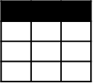
Evolving Approaches to Analytics EDWs to Data Lakes
Extract
Transform
Load
OLTP
…
EDW
(SQL Svr, Teradata, etc)
Original Data
ETL Tool
(SSIS, etc)
Transformed Data
BI Tools
ERP
LOB
Data Marts
Data Lake(s)
Dashboards
Apps

Slide 8
Evolving Approaches to Analytics EDWs to Data Lakes
Extract
Transform
Load
OLTP
…
EDW
(SQL Svr, Teradata, etc)
Original Data
ETL Tool
(SSIS, etc)
Transformed Data
BI Tools
ERP
LOB
Data Marts
Data Lake(s)
Dashboards
Devices
Social
Ingest (EL)
Apps
Sensors
Original Data
Web

Slide 9
Evolving Approaches to Analytics EDWs to Data Lakes
Extract
Transform
Load
OLTP
…
EDW
(SQL Svr, Teradata, etc)
Original Data
ETL Tool
(SSIS, etc)
Transformed Data
BI Tools
ERP
LOB
Data Marts
Data Lake(s)
Dashboards
Devices
Social
Ingest (EL)
Scale-out Storage & Compute
(HDFS, Blob Storage, etc)
Apps
Sensors
Original Data
Web
Streaming data
Transform & Load

Slide 10
Evolving Approaches to Analytics EDWs to Data Lakes
Extract
Transform
Load
OLTP
…
EDW
(SQL Svr, Teradata, etc)
Original Data
ETL Tool
(SSIS, etc)
Transformed Data
BI Tools
ERP
LOB
Data Marts
Data Lake(s)
Dashboards
Devices
Social
Ingest (EL)
Scale-out Storage & Compute
(HDFS, Blob Storage, etc)
Apps
Sensors
Original Data
Web
Streaming data
Transform & Load

Slide 11
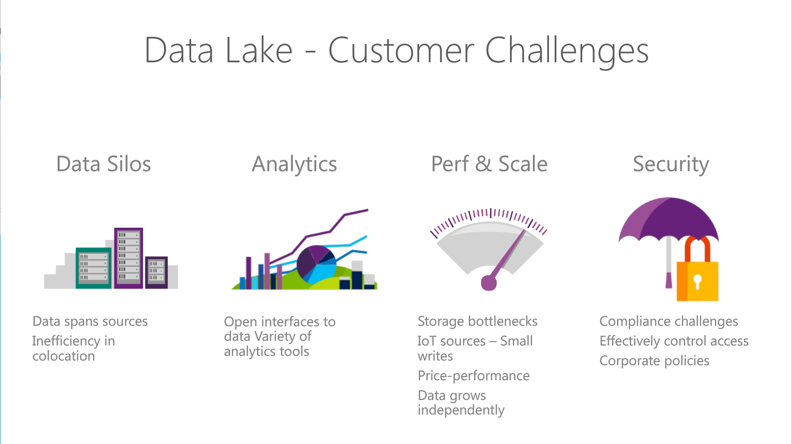
Notes:
Objetive – explain what are the Customer challeges that Azure Data Lake solution addresses
Read through the points.

Slide 12
The 3 Azure Big Data Services
HDInsight
Analytics
Store
Clusters as a service
Big data queries as a service
Hyper-scale Storage optimized for analytics
Big data as a service,
Cluster-less – no infrastructure to manage
Notes:
Slide objective – explain which services make up Azure Data Lake offering. The presentation will focus on Azure Data Lake Store and Analytics.
Talking points there are 3 main services in Azure

Slide 13
The Intelligent Lake
Petabytes of Data + Intelligence
Data Lake Store
No-limits data Lake
Petabyte-sized files
Trillions of objects
Scalable I/O for parallel analytics
Enterprise-grade Security
Data Lake Analytics
Analytics job service
Scale instantly
Scale per job
Infused with Artificial Intelligence

Slide 14
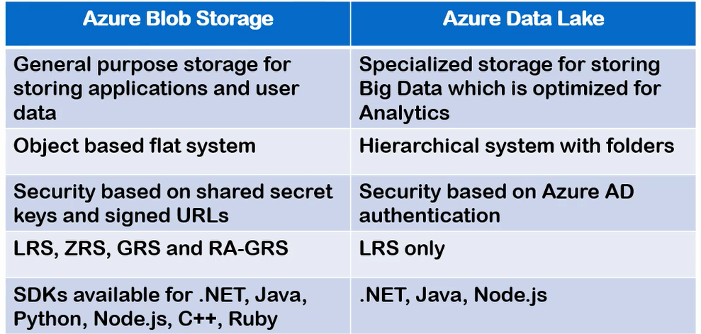
Azure Data Lake Storage Gen 1

Slide 15
Azure Data Lake Storage Gen 2
Performance:
The hierarchical namespace greatly improves the performance of directory management operations, which improves overall job performance.
Management :
Organize and manipulate files through directories and subdirectories.
Security :
Enforceable because you can define POSIX permissions on directories or individual files.
Cost effectiveness :
Built on top of the low-cost Azure Blob storage.

Slide 16
ADLS Gen1 + BLOB = ADLS Gen 2
Use | Data Lake Store | Blob Storage | Data Lake Gen 2
Hot/Cold Storage Tiers | No | Yes | Yes
Redundant Storage | No | Yes | Yes
AD Security | Yes | No | Yes
HDFS Compatible | Yes | No | Yes

Slide 17
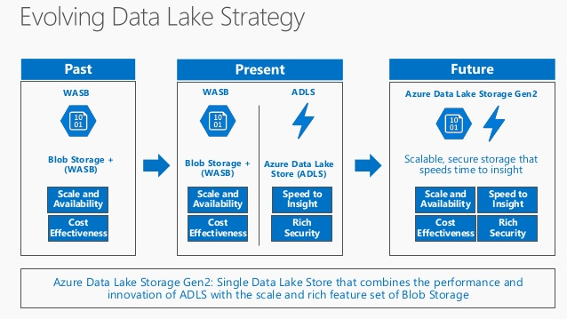
ADLS Gen1 + BLOB = ADLS Gen2

Slide 18
Azure Data Lake Use Cases

Slide 19
Data Lake Analytics Scenario
ON-PREMISES
AZURE
CONSUMPTION
Data Lake
Web Portals
Customer Behavior
Store
ETL & Analytics
Cleanup, Normalize, Basic Stats
Experimentation
A/B testing at scale. Drive changes based on actual
Customer behavior
Machine Learning
Do ML at Scale (Customer Segmentation & Fraud Detection)
SQL DW
Analytics
Move via Data Factory
Mobile Apps
Move via Data Factory
SQL DB
Clickstream
HDInsight
Power BI
DBs
Data Science
Notebooks
Notes:
Discuss how Azure data Lake fits into analytics scenarios

Slide 20
Retail Scenario Implementation
ON-PREMISES
CLOUD
CONSUMPTION
Massive Archive
Web Portals
Initial one time import
“Landing Zone”
Data Lake Store
DW (many instances)
On-Prem HDFS
Mobile Apps
via AzCopy
Curated Data
Data is portioned into multiple SQL DWs (one per data consumer. Several hundred consumers)
Power BI
Incremental
updates
Experimentation
Machine Learning
A/B testing at scale. Drive changes based on actual
Customer behavior
Do ML at Scale (Customer Segmentation & Fraud Detection)
Active Incoming Data
Jupyter
Notebooks
Notes:
Discuss how the previous scenario can fir into a concrete scenario for retail sector .
Here we use ADLS as store to where dat is uploaded from on-premise HDFS cluster and it analysed to extract additional insight using machine learning techniques
To do fraud prediction or customer segmentation. The data can then be suploaded to SQL data warehose to which various clients connect to conume data.

Slide 21
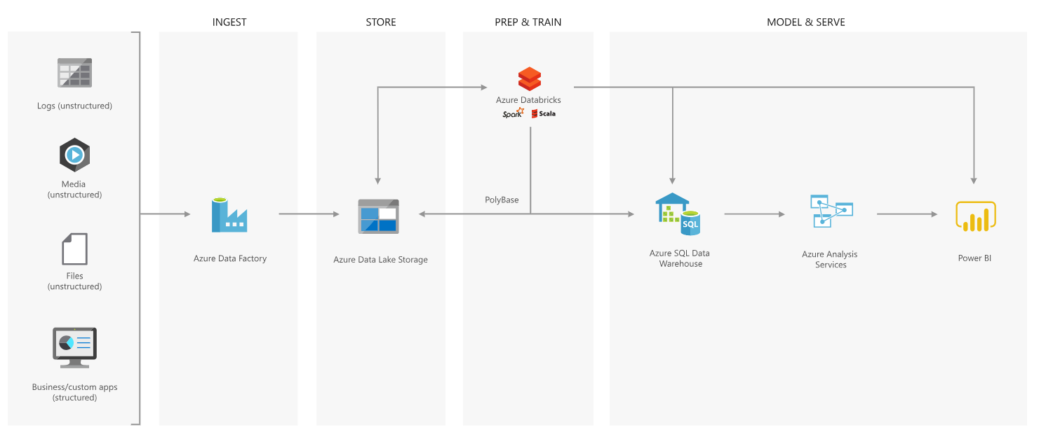
Best Practices – Modern Data Warehouse

Slide 22
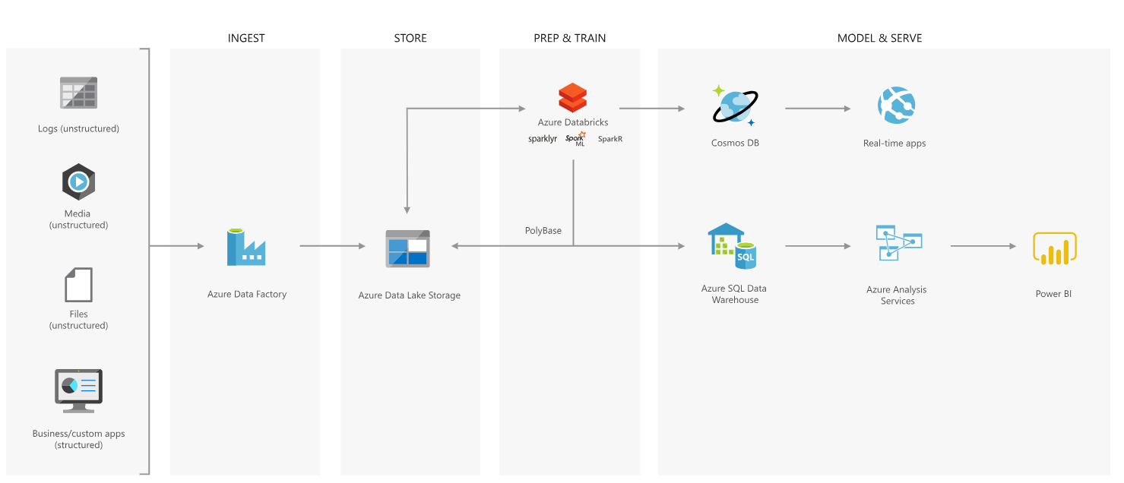
Advanced Analytics Approach

Slide 23

Azure Data Lake Store
Notes:
Lets have a look at the Data Lake Store service in more detail

Slide 24
Introducing Azure Data Lake Store
A hyper-scale repository for big data analytics workloads
Store ANY DATA in its native format
HADOOP FILE SYSTEM (HDFS) for the cloud
ENTERPRISE GRADE
No limits to SCALE
Optimized for analytic workload PERFORMANCE
Notes:
Objective: This is the introductory slide for Azure Data Lake Store.
Talking Points:
Microsoft describes Data Lake Store as a “hyper-scale repository for big data analytic workloads.” Azure Data Lake Store is an enterprise wide hyper-scale repository for big data analytic workloads.
Any Data - This lets you store all of your data and analyze them in their native format.
Hadoop File System - Azure Data Lake Store is a Hadoop file system which is compatible with HDFS and works with the Hadoop ecosystem.
Enterprise Grade - Azure Data Lake Store provides industry standard availability and reliability and also provides enterprise grade security for all data.
Scale - Azure Data Lake Store provides unlimited storage and is suitable for storing a variety of data.
Performance - Azure Data Lake Store is built for running large scale analytic systems that require massive throughput to query and analyze large amounts of data.

Slide 25

The Data Lake Approach
Ingest all data regardless of requirements
Store all data
in native format without schema definition
Do analysis
Using analytic engines like Hadoop and ADLA
Devices
Social
Batch queries
LOB applications
Video
Devices
Interactive queries
LOB applications
Social
Sensors
Real-time analytics
Web
Sensors
Video
Machine Learning
Relational
Web
Clickstream
Data warehouse
Relational
Clickstream
Notes:
Motivation – explain that ALS Store is Load Transform and Extract rather than ETL. You essentially postpone the schema definition until the extraction time.
A data lake is an enterprise wide repository of every type of data collected in a single place. Data of all types can be arbitrarily stored in the data lake prior to any formal definition of requirements or schema for the purposes of operational and exploratory analytics. Advanced analytics can be done using Hadoop, Machine Learning tools, or act as a lower cost data preparation location prior to moving curated data into a data warehouse. In these cases, customers would load data into the data lake prior to defining any transformation logic.
This is bottom up because data is collected first and the data itself gives you the insight and helps derive conclusions or predictive models.

Slide 26
Azure Data Lake Architecture
Compute
ADL Analytics
HDInsight
YARN
U-SQL
Hive | Spark | Storm
Data
WebHDFS
ADL Store
1
1
1
1
1
1
1
1
1
1
1
1
Notes:
Goal – explain the Azure data Lake logical architecture.
Azure Data Lake Store is secured, massively scalable, and built to the open HDFS standard, allowing you to run massively-parallel analytics . It is accessible via Web HDFS API so any tools that use that API will work with ASLS.
Azure Data Lake Analytics is a service that allows you to run massively parallel big data jobs such as data transformation and processing programs in U-SQL, R, Python, and .NET over petabytes of data.
It is build on top of YARN.
HDInsight is the fully-managed cloud Apache Hadoop offering that gives you optimized open-source analytic clusters for Spark, Hive, MapReduce, HBase, Storm, Kafka, and Microsoft R Server.
By default it uses Azure Blob storage however it can also be configured to use Azure Data Lake Store as a secondary storage or primary storage (HDInsigth 3.5 or later)
“Create HDInsight clusters with Data Lake Store by using the Azure portal”
https://docs.microsoft.com/en-us/azure/data-lake-store/data-lake-store-hdinsight-hadoop-use-portal
In this presenation we will cover Azure Data Lake Store and Azure Data Lake Analytics only.
------------------
Explain the acrronyms
HDFS HDFS is a distributed, scalable, and portable file system written in Java for the Hadoop framework. HDFS stores large files (typically in the range of gigabytes to terabytes^{[65]}) across multiple machines in a Hadoop cluster
YARN is the architectural center of Hadoop that allows multiple data processing engines such as interactive SQL, real-time streaming, data science and batch processing to handle data stored in a single platform, unlocking an entirely new approach to analytics.
Web HDFS is a REST Based API that allows external application needs to manipulate HDFS e.g: create directories and write files to that directory or read the content of a file stored on HDFS (Hadoop
Dstributed File System).

Slide 27



A hyper-scale repository for big data analytics workloads
Big Data Stores
Devices
Social
ADL Analytics
Data Lake Store
LOB Applications
Video
HDInsight
ADL Store
SQL Data
Warehouse
Web
Sensors
R
Spark
Relational
Clickstream
Machine Learning
A Hadoop Distributed File System for the cloud
No fixed limits on file size
No fixed limits on account size
Unstructured and structured data in their native format
Massive throughput to increase analytic performance
High durability, availability, and reliability
Azure Active Directory access control
Notes:
Your data are valuable assets to your organization and have both present and future value. Because of this, all data should be stored for future analysis. Today this is often not done because of the restrictions of traditional analytics infrastructure, like the pre-definition of schemas, the cost of storing large datasets, and the propagation of different data silos.
To address this challenge, the data lake concept was introduced as an enterprise-wide repository to store every type of data collected in a single place. For the purpose of operational and exploratory analytics, data of all types can be stored in a data lake prior to defining requirements or schema.
Microsoft Azure Data Lake Store is a Hadoop file system that’s compatible with Hadoop Distributed File System (HDFS) and works with the Hadoop ecosystem. Data Lake Store is integrated with Azure Data Lake Analytics and Azure HDInsight and will be integrated with Microsoft offerings like Revolution-R Enterprise; industry-standard distributions like Hortonworks, Cloudera, and MapR; and individual Hadoop projects like Spark, Storm, Flume, Sqoop, and Kafka.
Data Lake Store is a very open, massive scale data store designed for extremely high throughput and low latency for analytics workloads.
At the same time, its built-in security ensures you can include even your most critical workloads on it.
T: You may have noticed we are emphasizing these services are all built to scale, and SQL Data Warehouse is no different.

Slide 28


Any data
Devices
Video
Unstructured
Semi-structured
Structured
Clickstream
Web
Social
Sensors
Relational
LOB applications
Notes:
Objective: This slide is about how Azure Data Lake Store can store any type of data.
Talking Points:
Data Lake Store allows you to store relational and non-relational data. It also does not require a schema to be defined before the data is loaded. This data can be from devices, videos, and web applications. Here data can be further classified into:
Unstructured Data - This data either does not have predefined data model or is not organized. It is typically text-heavy and may contain data like dates, numbers, and facts.
Semi-Structured Data - These are self-describing structures that do not conform with the formal structure of data models associated with the relational database or other forms of data tables.
Structured Data - This data resides in a fixed field within a record file. It includes data contained in relational databases and spreadsheets.

Slide 29



Durable and highly available
Automatically replicates your data
Three copies within a single region
Highly available
Notes:
Objective: This slide shows how data is durable and highly available with Azure Data Lake Store.
Talking Points:
One of the prior requirements is the availability of data at any place and any time. ADL Store provides industry standard availability and reliability in the following ways:
The ADL Store Automatically replicates the data to help against unexpected hardware failures and make sure it is available when you need it.
Azure Data Lake automatically replicates your data to help guard against unexpected hardware failures and make sure it's available when you need it. We keep three copies within a single region.

Slide 30
Unlimited storage
PB
TB
GB
Unlimited account sizes
Individual file sizes from gigabytes to petabytes
No limits to scale
TB
PB
Notes:
Objective: This slide shows how Azure Data Lake supports unlimited storage.
Talking Points:
Azure Data Lake Store provides unlimited storage and is suitable for storing a variety of data for analytics.
Azure Data Lake has unbounded scale with no limits to how much data can be stored in a single account.
While other cloud storage offerings might restrict individual file sizes to 5 terabytes, Azure Data Lake can store very large files in the petabytes (200x larger) with immediate read/write access and high throughput useful for scenarios like high resolution videos, scientific, medical, large backup data, event streams, web logs, IoT scenarios, and more.
Everything can be collected and stored in Azure Data Lake without restriction or prior understanding of business requirements.

Slide 31
Azure Data Lake Analytics
2016/05/17

Slide 32
Agenda
Origins
Cosmos
Futures
Layers & Components
Storage
Parallelization
Job Scheduling
Query Execution
Performance
Demo

Slide 33
Quick Recap

Slide 34
ADL VS SQL DB
Azure Data Lake
ADL Analytics + ADL Store
SQL DB
SQL Query + DB Storage

Slide 35
Familiar syntax to millions of SQL & .NET developers
Unifies declarative nature of SQL with the imperative power of C#
Unifies structured, semi-structured and unstructured data
Distributed query support over all data
U-SQL
A new language for Big Data

Slide 36
History

Slide 37
History
Bing needed to…
Understand user behavior
And do it…
At massive scale
With agility and speed
At low cost
So they built …
Cosmos
Cosmos
Batch Jobs
Interactive
Machine Learning
Streaming
Thousands of Developers

Slide 38
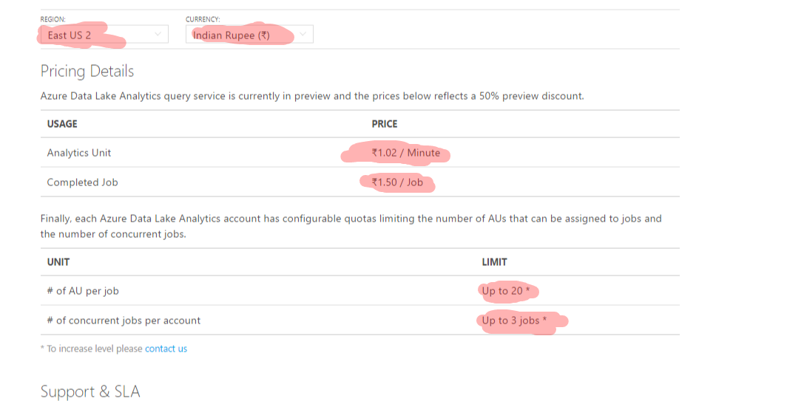
Pricing

Slide 39
Azure Data Lake Analytics (ADLA) Demo

Slide 40
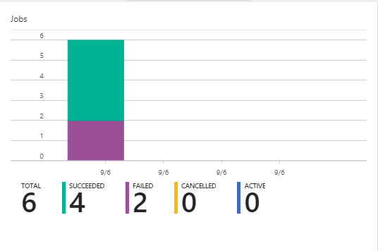

Slide 41
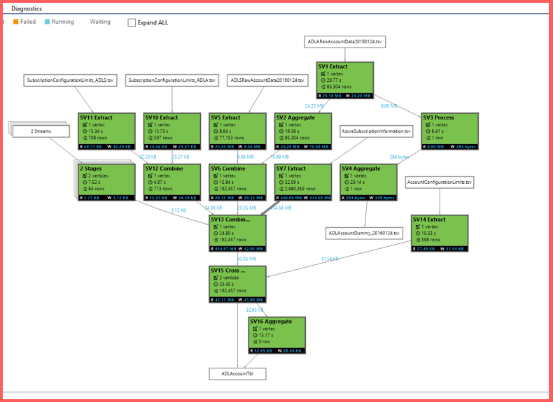

Slide 42
Job Scheduling States, Queue, Priority

Slide 43
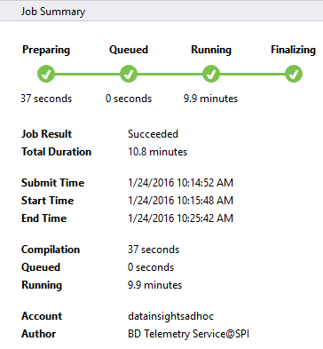
Job Status

Slide 44
UX
Job State
Preparing
New
The script is being compiled by the Compiler Service
Compiling
All jobs enter the queue.
Queued
Queued
Are there enough ADLAUs to start the job?
Scheduling
Starting
If yes, then allocate those ADLAUs for the job
Running
Running
The U-SQL runtime is now executing the code on 1 or more ADLAUs or finalizing the outputs
Finalizing
Ended
(Succeeded, Failed, Cancelled)
Ended
The job has concluded.

Slide 45
Preparing: Upload your script to the cloud, compiling and optimizing the script using the compile service.
Queued: Jobs are queued whey they are waiting for enough resources, or the jobs exceed the max concurrent jobs per account limitation. The priority setting determines the sequence of queued jobs - the lower the number, the higher the priority.
Running: The job is actually running in your Data Lake Analytics account.
Finalizing: The job is completing (for example, finalizing the file).
The job can fail in every phase. For example, compilation errors in the Preparing phase, timeout errors in the Queued phase, and execution errors in the Running phase, etc.

Slide 46
Why does a Job get Queued?
Local Cause
Conditions:
Queue already at Max Concurrency
Global Cause (very rare)
Conditions:
System-wide shortage of ADLAUs
System-wide shortage of Bandwidth
* If these conditions are met, a job will be queued even if the queue is not at its Max Concurrency

Slide 47
The Job Queue
When a job is at the top of the queue, it will start running.
Running jobs
The queue is ordered by job priority.
Lower numbers -> higher priority.
1 = highest.
Defaults:
Max Running Jobs = 3
Max Tokens per job = 20
Max Queue Size = 200

Slide 48
Priority Doesn’t Preempt Running Jobs
A
C
X
B
X has Pri=1.
These are all running and have very low priority (pri=1000)
X will NOT preempt running jobs. X will have to wait.

Slide 49
U-SQL Job Compilation

Slide 50
U-SQL Compilation Process
U-SQL Metadata Service
Compilation output (in job folder)
C#
managed dll
C++
Unmanaged dll
Compiler & Optimizer
Algebra
Other files
(system files, deployed resources)
Deployed to Vertices

Slide 51
The Job Folder
Inside the Default ADL Store:
/system/jobservice/jobs/Usql/YYYY/MM/DD/hh/mm/JOBID
/system/jobservice/jobs/Usql/2016/01/20/00/00/17972fc2-4737-48f7-81fb-49af9a784f64

Slide 52
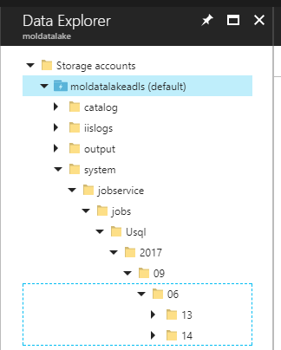
Job folder Structure
/system/jobservice/jobs/Usql/YYYY/MM/DD/hh/mm/JOBID

Slide 53
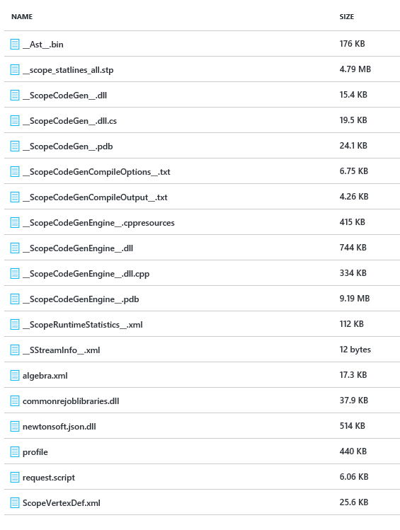
Job Folder Contents
C# code generated by the U-SQL Compiler
C++ code generated by the U-SQL Compiler
Cluster Plan a.ka. “Job Graph” generated by U-SQL Compiler
User-provided .NET Assemblies
User-provided USQL script

Slide 54
Query Execution Plans, Vertices, Stages, Parallelism, ADLAUs

Slide 55
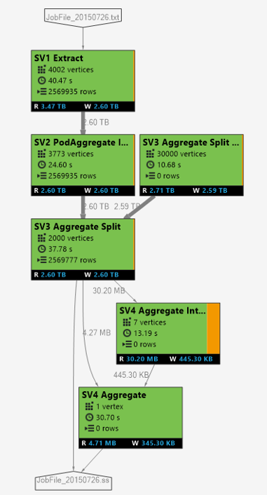
Logical -> Physical Plan
Vertexes in each SuperVertex (aka “Stage) are doing the same operation on different parts of the same data.
Vertexes in a later stages may depend on a vertex in an earlier stage
Each square = “a vertex” represents a fraction of the total
Visualized like this

Slide 56
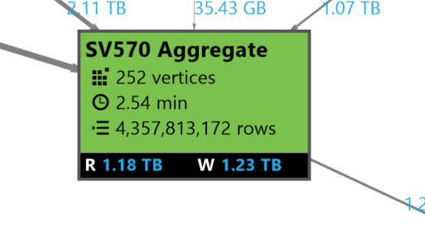
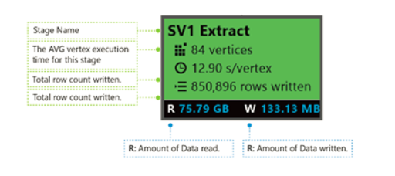
Stage Details
252 Pieces of work
AVG Vertex execution time
4.3 Billion rows
Data Read & Written

Slide 57
Coloring
Colors: Colors are used in the stage to indicate different vertex status.
Green indicates the vertex is succeeded.
Orange indicates the vertex is retried. The retried vertex was failed but is retried automatically and successfully by the system, and the overall stage is completed successfully. If the vertex retried but still failed, the color turns red and the whole job failed.
Red indicates failed, which means a certain vertex had been retried a few times by the system but still failed. This scenario causes the whole job to fail.
Blue means a certain vertex is running.
White indicates the vertex is Waiting. The vertex may be waiting to be scheduled once an ADLAU becomes available, or it may be waiting for input since its input data might not be ready.

Slide 58
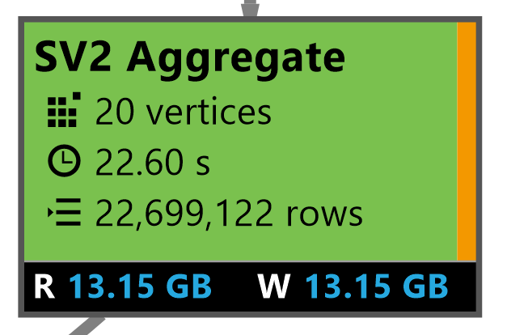
Automatic Vertex retry
A vertex failed … but was retried automatically
A vertex might fail because:
Router congested
Hardware failure (ex: hard drive failed)
VM had to be rebooted
U-SQL job will automatically schedule a vertex on another VM.
Overall Stage Completed Successfully

Slide 59
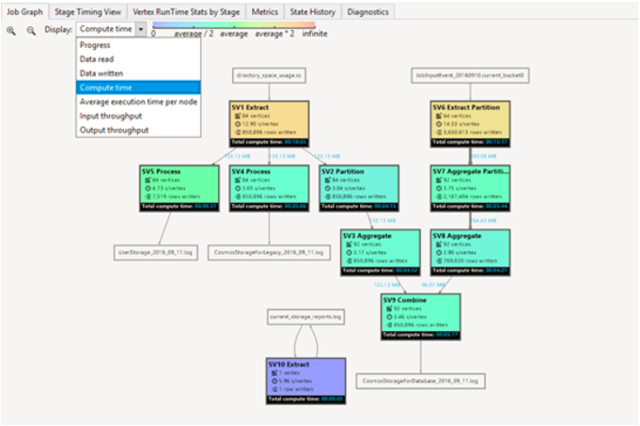
Coloring

Slide 60
ADLAUs
Azure
Data
Lake
Analytics
Unit
Parallelism N = N ADLAUs
1 ADLAU ~=
A VM with 2 cores and 6 GB of memory

Slide 61
Efficiency Cost vs Latency

Slide 62
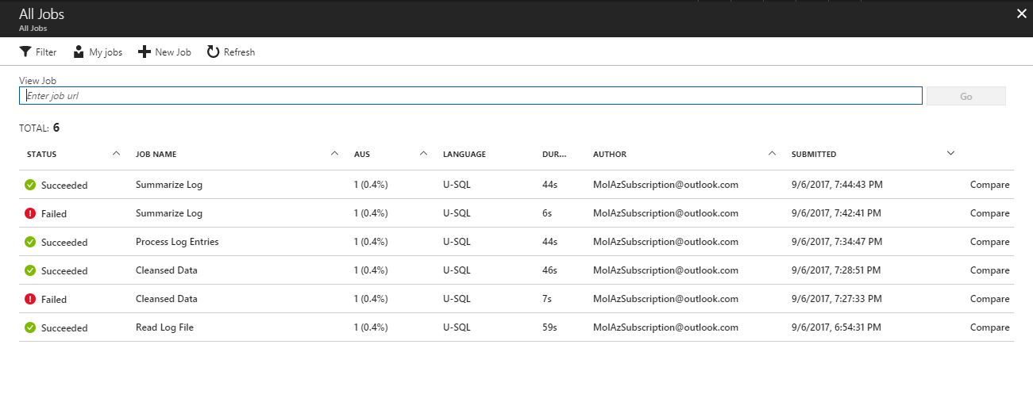

Slide 63
Allocation
Blue line: Allocated
Allocating 10 ADLAUs
for a 10 minute job.
Cost
= 10 min * 10 ADLAUs
= 100 ADLAU minutes
Time

Slide 64
Over Allocation
Consider using fewer ADLAUs
You are paying for the area under the blue line
You are only using the area under the red line
Time

Slide 65
Vertex Execution

Slide 66
Store Basics
A VERY BIG FILE
Files are split apart into Extents.
Extents can be up to 250MB in size.
For availability and reliability, extents are replicated (3 copies).
Enables parallelized read
1
2
3
4
5
1
2
3
4
5
1
2
3
4
5
1
2
3
4
5

Slide 67
Parallel writing
Front-end machines for a web service
Log files
Simultaneous
uploads
Azure Data lake

Slide 68
As file size increases, more opportunities for parallelism
Extent
Vertex
Extent
Vertex
Extent
Vertex
Extent
Vertex

Slide 69
The importance of partitioning input data

Slide 70
Search engine clicks data set
A log of how many clicks a certain domain got within a session
SessionID Domain Clicks
3 cnn.com 9
1 whitehouse.gov 14
2 facebook.com 8
3 reddit.com 78
2 microsoft.com 1
1 facebook.com 5
3 microsoft.com 11

Slide 71
Data Partitioning Compared
Extent 1
Extent 2
Extent 3
Extent 1
Extent 2
Extent 3
FB
FB
FB
FB
WH
CNN
WH
CNN
WH
CNN
WH
FB
WH
WH
CNN
FB
CNN
CNN
File:
Keys (Domain) are scattered across the extents
U-SQL Table partitioned on Domain
The keys are now “close together” also the index tells U-SQL exactly which extents contain the key

Slide 72
Click Data :
CREATE TABLE SampleDBTutorials.dbo.ClickData ( SessionId int, Domain string, Clinks int, INDEX idx1 //Name of index CLUSTERED (Domain ASC) //Column to cluster by ); INSERT INTO SampleDBTutorials.dbo.ClickData SELECT * FROM @clickdata;

Slide 73
Find all the rows for cnn.com
// Using a File
@ClickData =
SELECT
Session int,
Domain string,
Clicks int
FROM “/clickdata.tsv”
USING Extractors.Tsv();
@rows = SELECT *
FROM @ClickData WHERE Domain == “cnn.com”;
OUTPUT @rows
TO “/output.tsv”
USING Outputters.tsv();
// Using a U-SQL Table partitioned by Domain
@ClickData =
SELECT *
FROM MyDB.dbo.ClickData;
@rows = SELECT *
FROM @ClickData WHERE Domain == “cnn.com”;
OUTPUT @rows
TO “/output.tsv”
USING Outputters.tsv();

Slide 74
File
U-SQL Table Partitioned by Domain
CNN,
FB,
WH
CNN,
FB,
WH
CNN,
FB,
WH
FB
WH
CNN
EXTENT 1
EXTENT 2
EXTENT 3
EXTENT 1
EXTENT 2
EXTENT 3
Read
Read
Read
Read
Filter
Filter
Filter
Filter
Write
Write
Write
Write
Because “CNN” could be anywhere, all extents must be read.
Thanks to “Partition Elimination” and the U-SQL Table, the job only reads from the extent that is known to have the relevant key

Slide 75
How many clicks per domain?
@rows = SELECT
Domain,
SUM(Clicks) AS TotalClicks FROM @ClickData GROUP BY Domain;

Slide 76
File
U-SQL Table Partitioned by Domain
FB
WH
CNN
CNN,
FB,
WH
CNN,
FB,
WH
CNN,
FB,
WH
EXTENT 1
EXTENT 2
EXTENT 3
EXTENT 1
EXTENT 2
EXTENT 3
Read
Read
Read
Read
Read
Read
Partial Agg
Partial Agg
Partial Agg
Full Agg
Full Agg
Full Agg
Partition
Partition
Partition
Write
Write
Write
Expensive!
Full Agg
Full Agg
Full Agg
Write
Write
Write

Slide 77
Data Factory

Slide 78
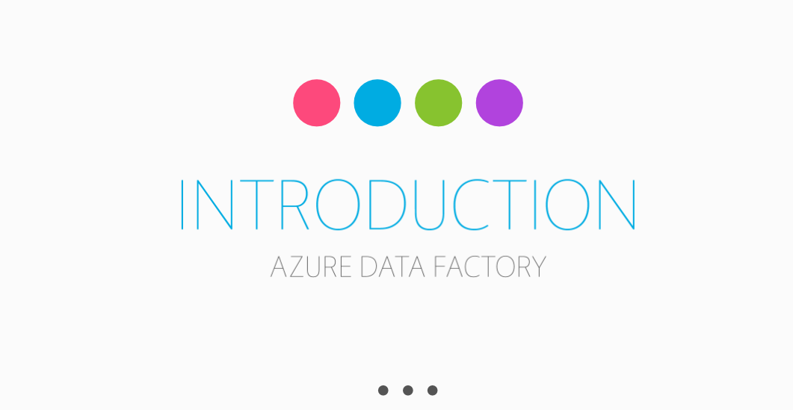

Slide 79
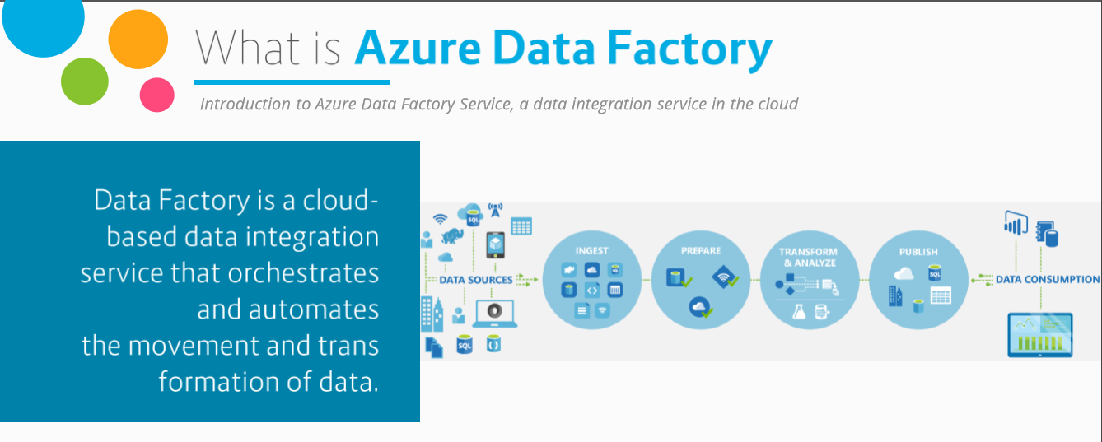
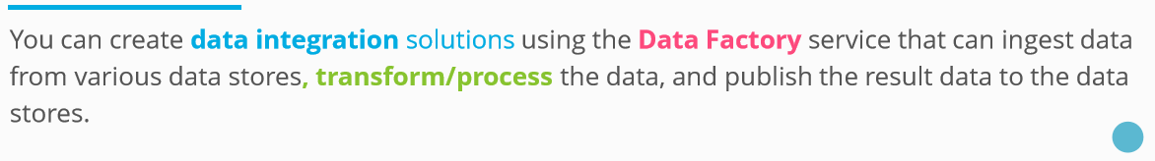

Slide 80
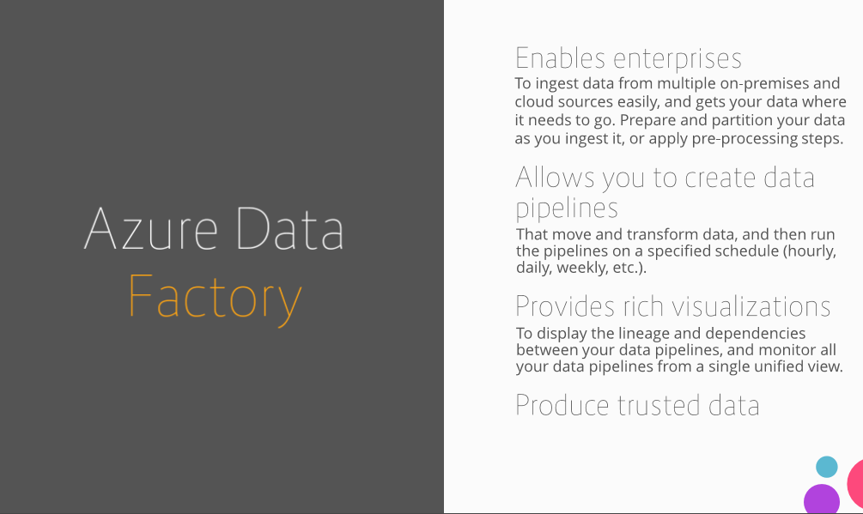

Slide 81
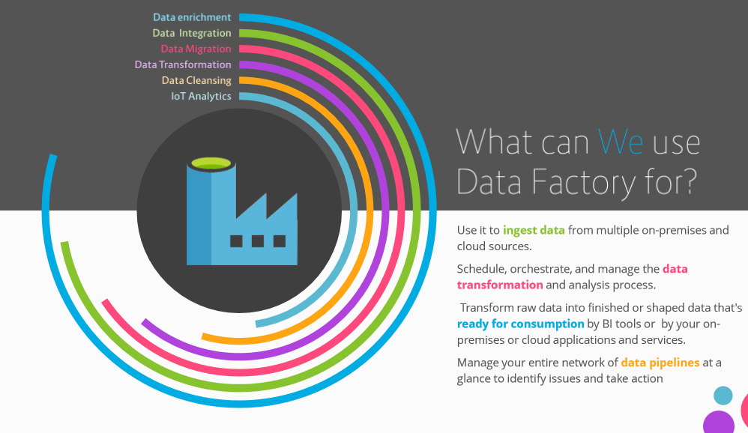

Slide 82
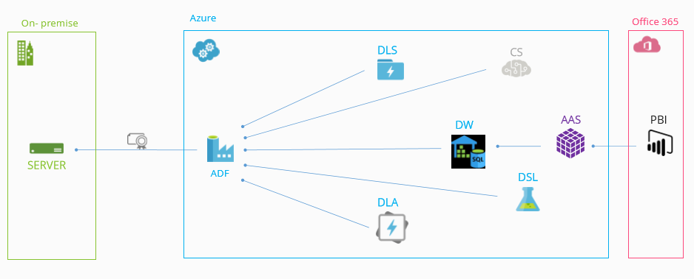
Data Sources Usage

Slide 83
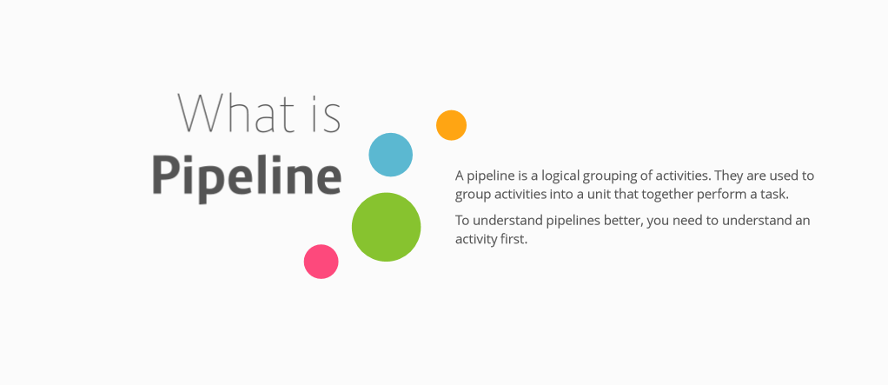

Slide 84
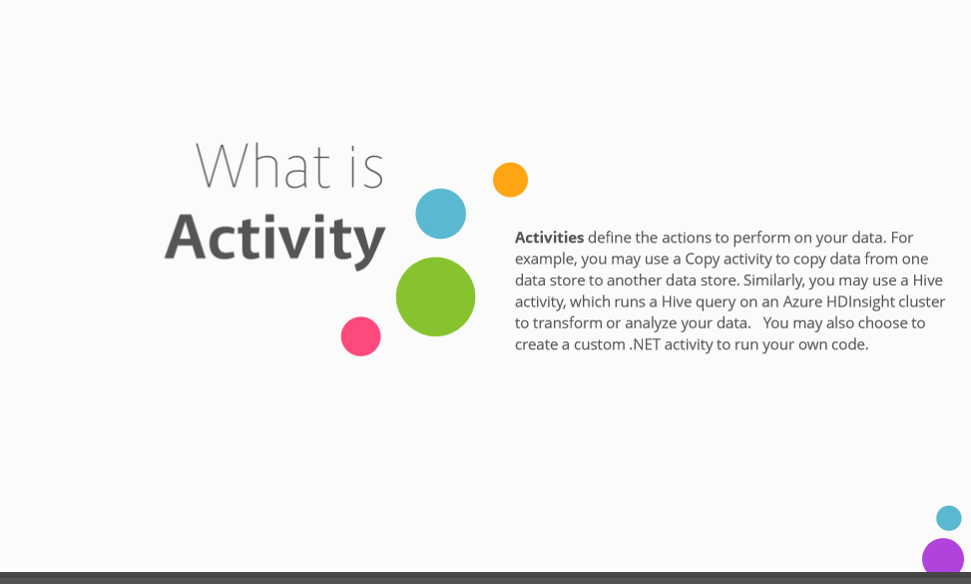

Slide 85
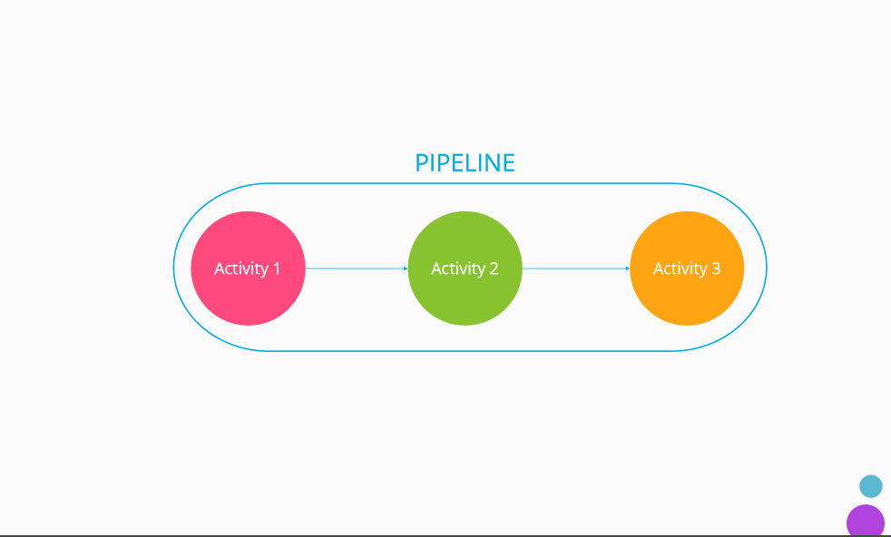

Slide 86
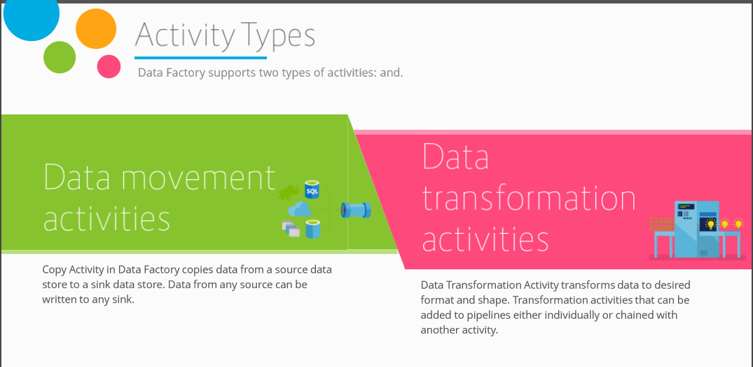

Slide 87
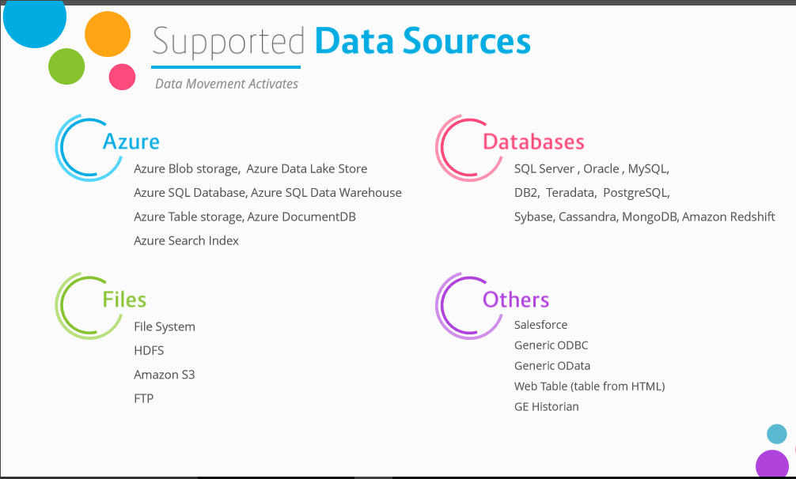

Slide 88
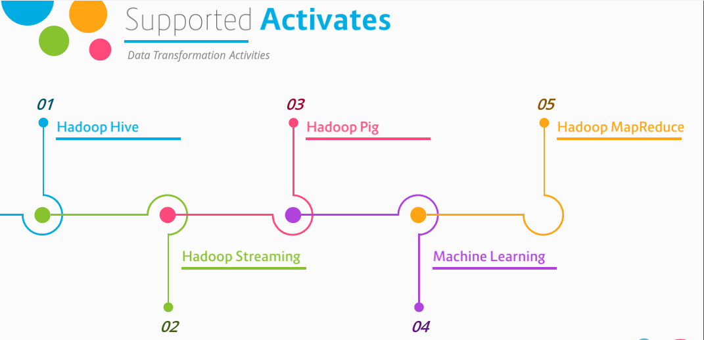

Slide 89
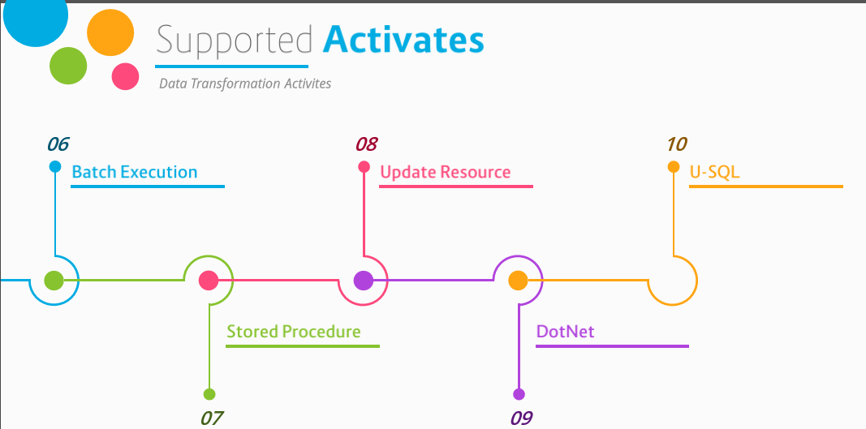

Slide 90
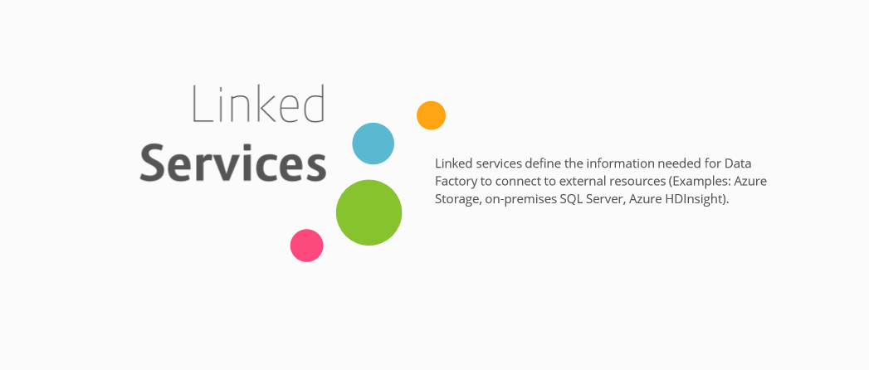

Slide 91
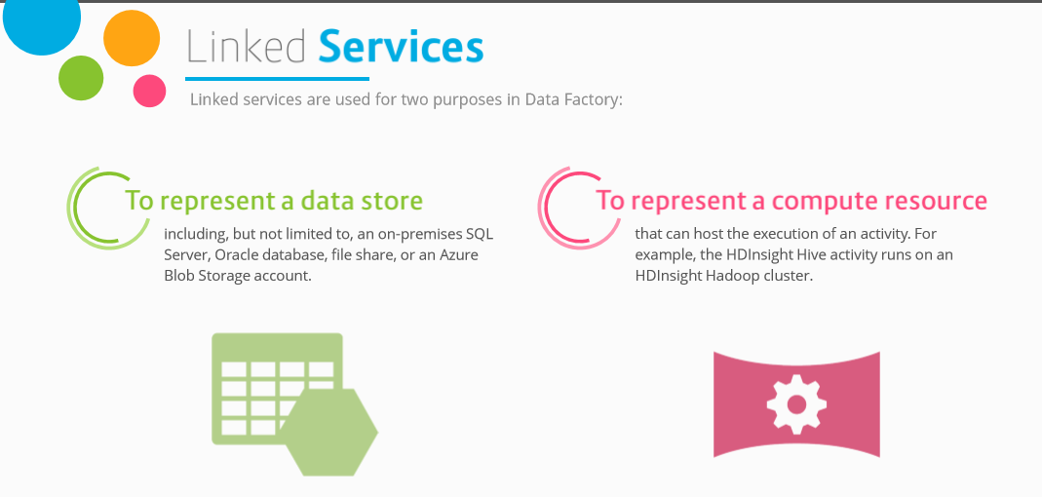

Slide 92
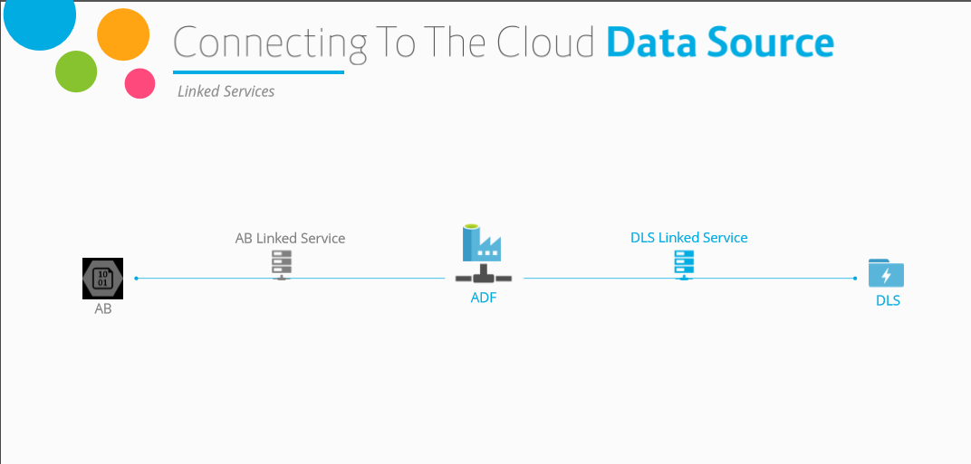

Slide 93
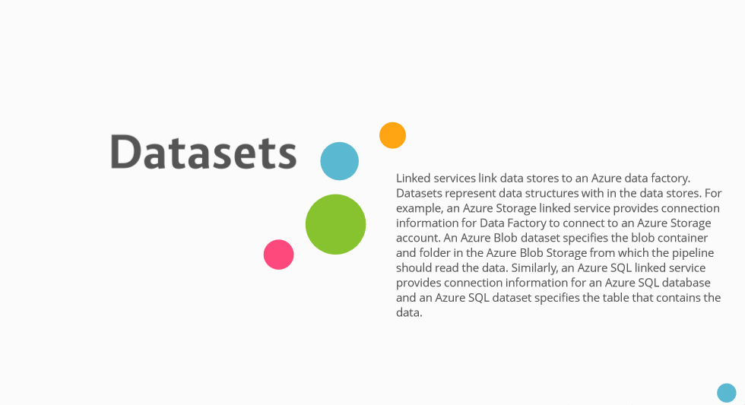

Slide 94
2. Create the Data Factory
Portal, PowerShell and Visual Studio
Notes:
Setting Up: https://azure.microsoft.com/en-us/documentation/articles/data-factory-build-your-first-pipeline/

Slide 95
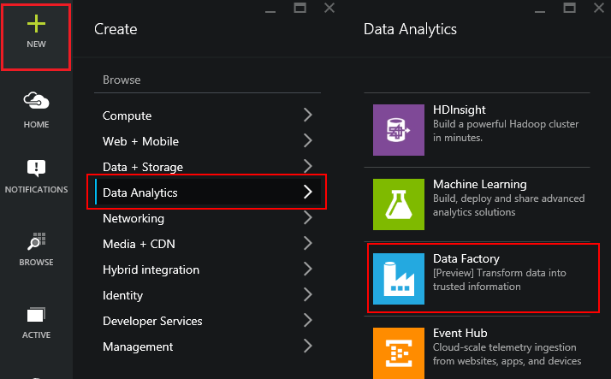
Using the Portal
Use in Non-MS Clients
Use for Exploration
Use when teaching or in a Demo
Notes:
LAB 2:
Open the file StudentWorkbook.txt
Complete Lab 2
Overview: https://azure.microsoft.com/en-us/documentation/articles/data-factory-build-your-first-pipeline/
Using the Portal: https://azure.microsoft.com/en-us/documentation/articles/data-factory-build-your-first-pipeline-using-editor/

Slide 96
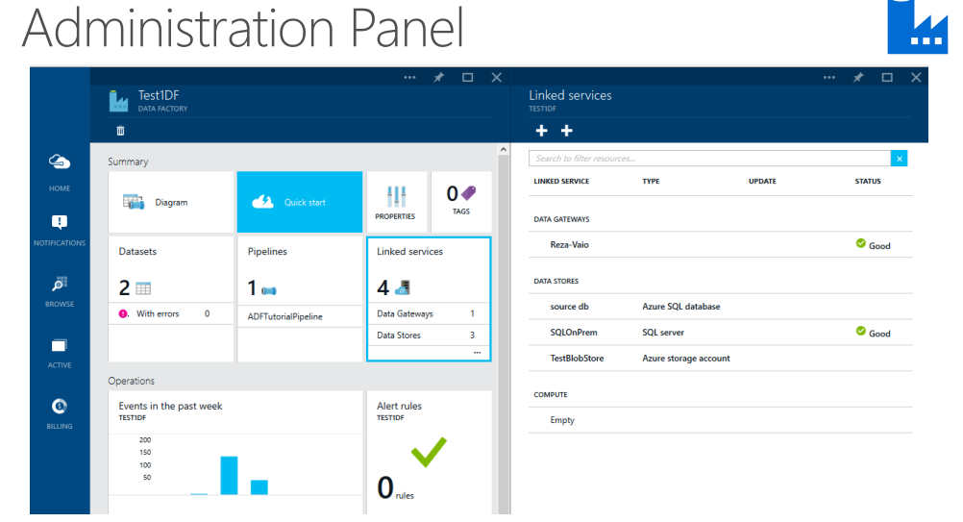

Slide 97
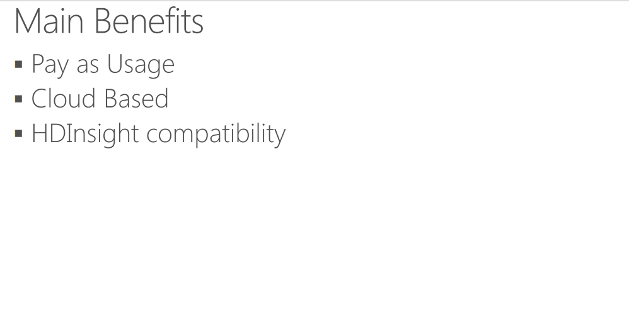

Slide 98
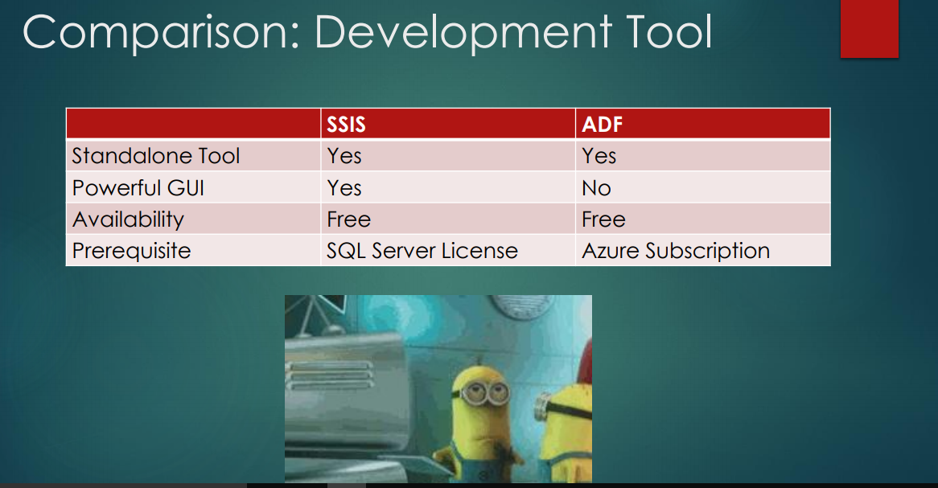

Slide 99
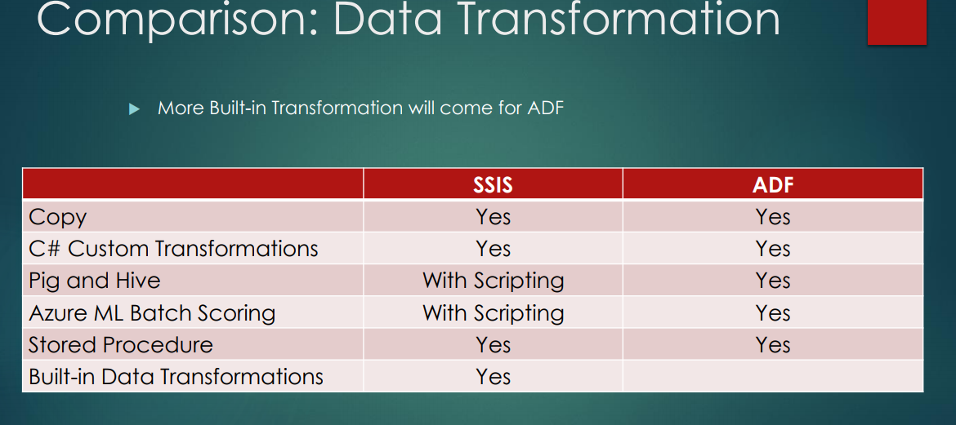

Slide 100
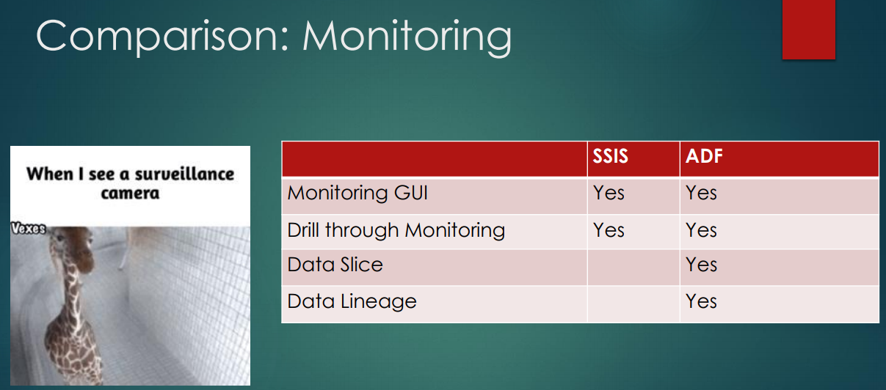

Slide 101
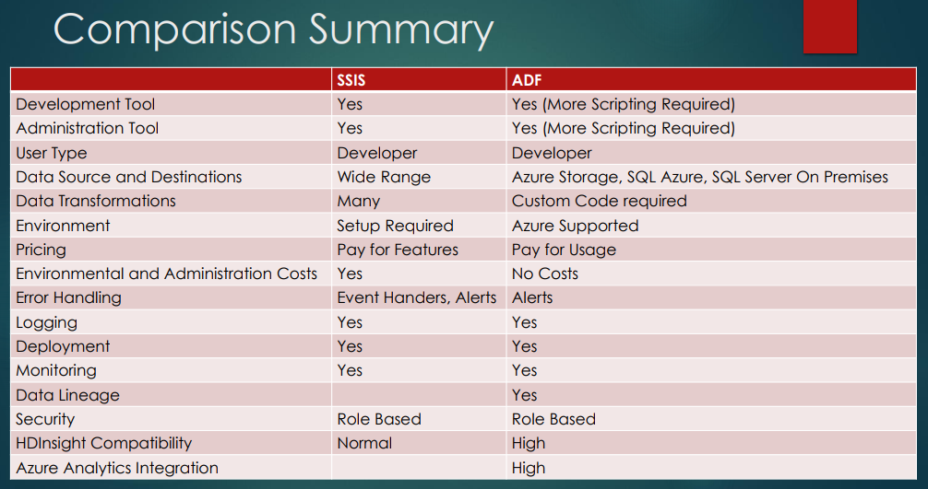

Slide 102
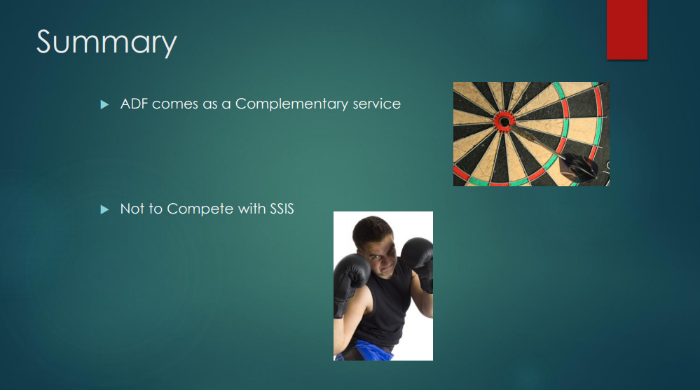

Slide 103
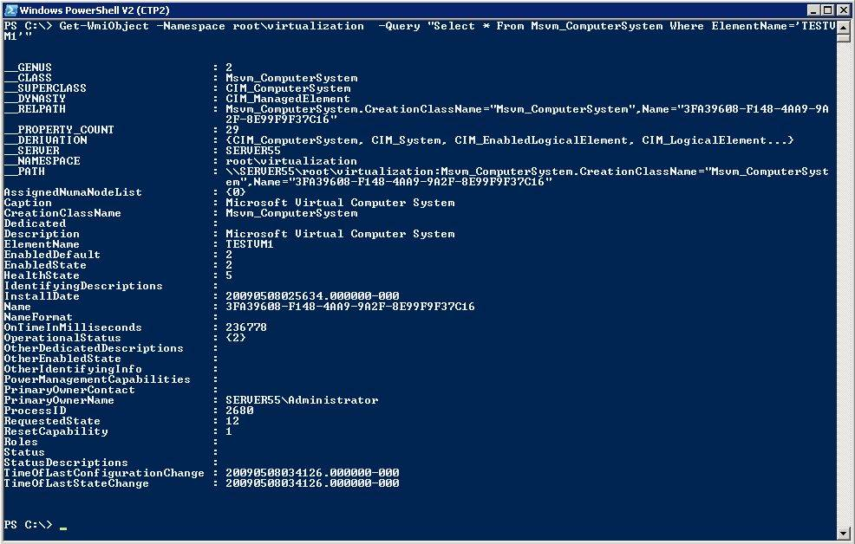
Using PowerShell
Use in MS Clients
Use for Automation
Use for quick set up and tear down
Notes:
Learning Path: https://azure.microsoft.com/en-us/documentation/articles/data-factory-introduction/
Full Tutorial: https://azure.microsoft.com/en-us/documentation/articles/data-factory-build-your-first-pipeline/

Slide 104
PowerShell ADF Example
Run Add-AzureAccount and enter the user name and password
Run Get-AzureSubscription to view all the subscriptions for this account.
Run Select-AzureSubscription to select the subscription that you want to work with.
Run Switch-AzureMode AzureResourceManager
Run New-AzureResourceGroup -Name ADFTutorialResourceGroup -Location "West US"
Run New-AzureDataFactory -ResourceGroupName ADFTutorialResourceGroup –Name DataFactory(your alias)Pipeline –Location "West US"
Notes:
https://azure.microsoft.com/en-us/documentation/articles/data-factory-build-your-first-pipeline-using-powershell/

Slide 105
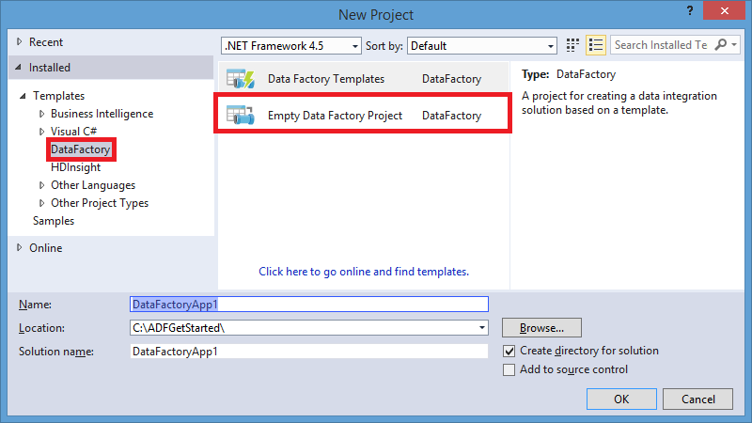
Using Visual Studio
Use in mature dev environments
Use when integrated into larger development process
Notes:
Overview: https://azure.microsoft.com/en-us/documentation/articles/data-factory-build-your-first-pipeline/
Using the Portal: https://azure.microsoft.com/en-us/documentation/articles/data-factory-build-your-first-pipeline-using-editor/

Slide 106
ADF V2

Slide 107
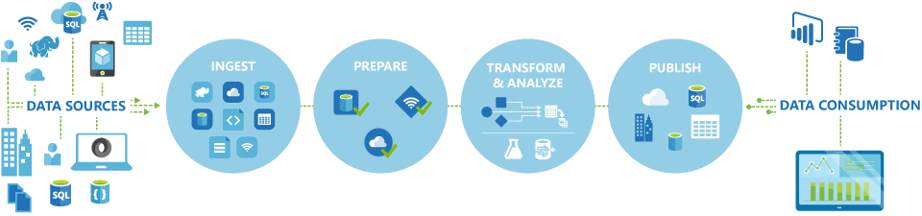
What is Azure Data Factory?
Notes:
Look at this scheme. Using Azure Data Factory, you can create and schedule data-driven workflows that can ingest data from disparate data stores, process/transform the data by using compute services such as Azure HDInsight Hadoop, Spark, Azure Data Lake Analytics, and Azure Machine Learning, and publish output data to data stores such as Azure SQL Data Warehouse for business intelligence (BI) applications to consume.
Now when you have an idea what ADF is we can move on to the main concepts.

Slide 108
Concepts
Data Source
Dataset
Pipeline
is a grouping of logically related activities. It is used to group activities into a unit that performs a task
Concepts
Activities define the actions to perform on your data. Each activity takes zero or more datasets as inputs and produces one or more datasets as output.
Activity
Linked services
computing environment
Notes:
We have four main concepts.
First. Dataset is data source
Second. Activity. It’s actions to perform on your data
Third. Pipeline. It’s a grouping of logically related activities
And finally. Linked services are computing environment or external resource. For example It’ s Hive, Machine Learning, stored procedure
Let’s look at these concepts in more detail

Slide 109
Expressions & Parameters
String functions – concat, substring, replace, indexof etc.
Collection functions – length, union, first, last etc.
Logic functions – equals, less than, greater than, and, or, not etc.
Conversation functions – coalesce, xpath, array, int, string, json etc.
Math functions – add, sub, div, mod, min, max etc.
Date functions – utcnow, addminutes, addhours, format etc.

Slide 110
System variables
Pipeline scope
Trigger scope
Variable Name
@pipeline().DataFactory
@pipeline().Pipeline
@pipeline().RunId
@pipeline().TriggerType
@pipeline().TriggerId
@pipeline().TriggerName
@pipeline().TriggerTime
Variable Name
trigger().scheduledTime
trigger().startTime

Slide 111
Development
Create ADF Objects and Deploy to ADFv2 .net using .net
PowerShell: Create ADF Objects and Deploy to ADFv2
Edit & PowerShell: Create ADF Objects per copy and paste and Deploy json artefacts using Powershel

Slide 112
Trigger

Slide 113
Type of triggers
Manual execution
Schedule trigger: A trigger that invokes a pipeline on a wall-clock schedule.
Tumbling window trigger: A trigger that operates on a periodic interval, while also retaining state.

Slide 114
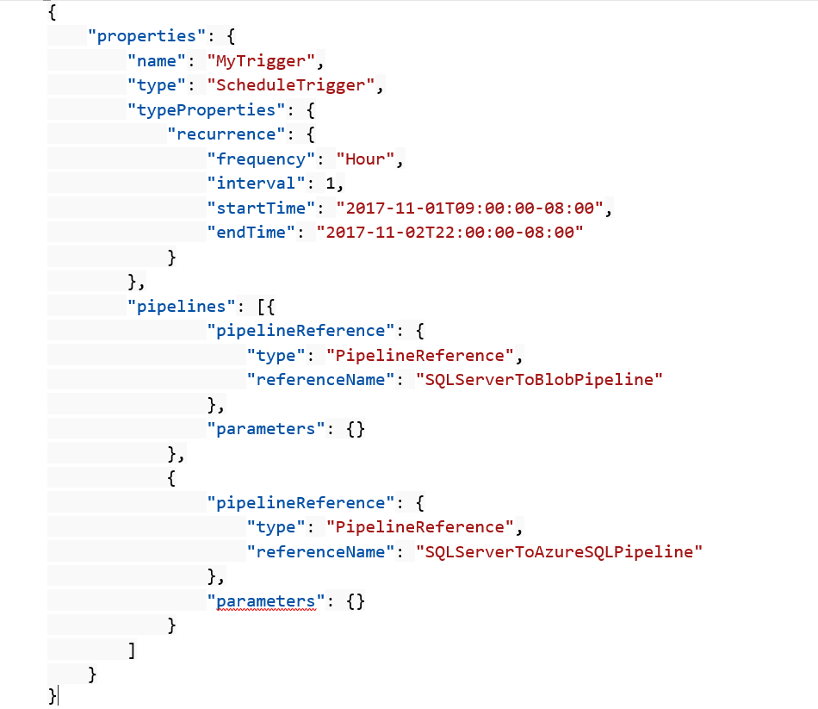
Schedule trigger
A schedule trigger runs pipelines on a wall-clock schedule. This trigger supports periodic and advanced calendar options. For example, the trigger supports intervals like "weekly" or "Monday at 5:00 PM and Thursday at 9:00 PM."

Slide 115
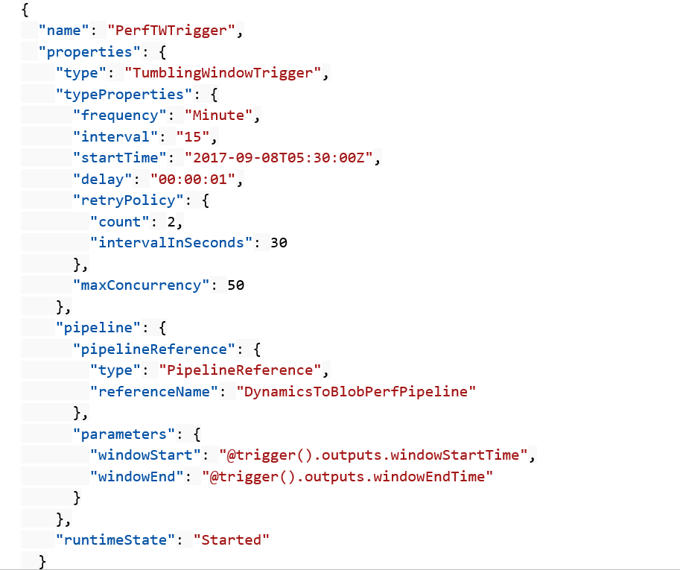
Tumbling window trigger
Tumbling window triggers are a type of trigger that fires at a periodic time interval from a specified start time, while retaining state. Tumbling windows are a series of fixed-sized, non-overlapping, and contiguous time intervals.

Slide 116
Control flow

Slide 117
Control flow
Filter activity
ForEach activity
Get metadata
Execute Pipeline
If Condition activity
Web activity
Lookup activity
Wait activity
Until activity

Slide 118
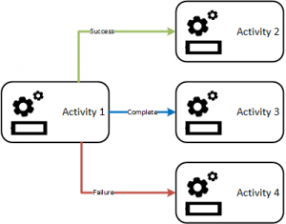
Branching
On success
On failure
On completion
On skip

Slide 119
END

